Slide 1
REALTIME WEATHER BASED SMART SPRINKLER SYSTEM FOR GOLF COURSE

Slide 2
Presented by :
JAY MISTRY
Industry Mentor :
Name : Gnaneshwar Bandari
Designation : IoT & Robotics Engineer
Company Name : SmartBridge Education Services Pvt Ltd
Contact Details : info@smartbridge.com

Slide 3
Outline of Presentation
Sr. No. | Title of Topic | Page No.
1 | Definition | 4
2 | Introduction to Project | 5
3 | Block Diagrams | 6
4 | Project Objectives | 7
5 | Hardware and Software | 8
6 | Sensor Details | 10
7 | Flowchart | 12
8 | Proof of Context | 13

Slide 4
Definition
Title : REALTIME WEATHER BASED SMART SPRINKLER SYSTEM FOR GOLF COURSE
Continuous monitoring and storage of weather and soil moisture information
Alert is generated if the soil moisture is above the threshold value
The water sprinklers can be controlled remotely using mobile app
Less latency in communication from device to cloud with MQTT

Slide 5
Introduction to Project
The parameters of the golf course are considered briefly, parameters such as Humidity and Soil Moisture.
The Sprinklers have been equipped with humidity sensor.
The sensor readings are uploaded to the Web Application, which further is stored into the Cloud Database.
There will be a machine learning model in the cloud which will detect the changes in climatic conditions considering the humidity or the temperature.
The changes in the parameters will lead the model to switch on/off the sprinkler motors accordingly.

Slide 6
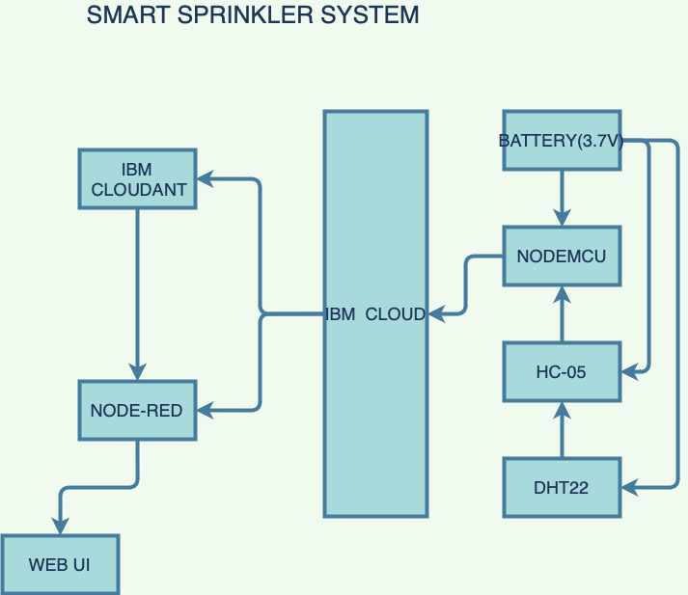
BLOCK DIAGRAM

Slide 7
Project Objectives
The Aim of this project is to create a system which could automatically detect the climate changes and dispense water from the sprinkler system accordingly.
The humidity parameters of the golf course are monitored regularly with the help of the Humidity sensor on the golf course.

Slide 8
Hardware & Software Designing
Hardware :
NodeMCU with ESP8266 for Establishing Server.
HC-05 used to establish connection between the moisture sensor and NodeMCU
DHT22 used to measure the humidity of the soil.

Slide 9
Hardware & Software Designing
Software:
IBM Cloud: Where the data is to be stored in the Cloudant, IBM Watson and Node-Red
Internet of Things App: This is included in the IBM Cloud where we feed the hardware credentials.
Arduino IDE: Used to upload and use the data on the sensor using software.
Node-Red: This connects the data flow by software credentials
IBM Watson: Used to generate the authentication token essential for connection

Slide 10
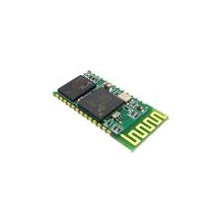
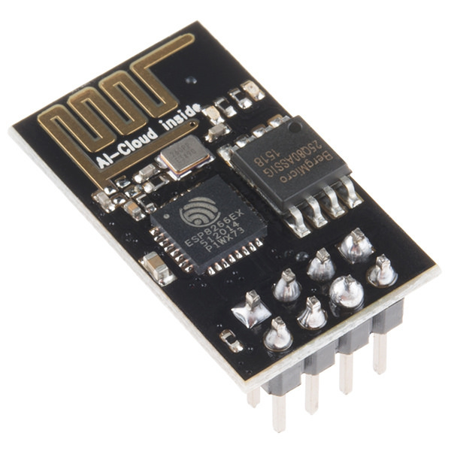
Sensor Details
ESP8266: The device that acts as a medium to successfully connect every sensor with the IBM Cloud.
HC-05: The sensor used to connect the DHT22 with ESP8266

Slide 11
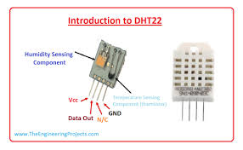
Sensor Details
DHT22: The sensor that is used to check the humidity level of soil.

Slide 12
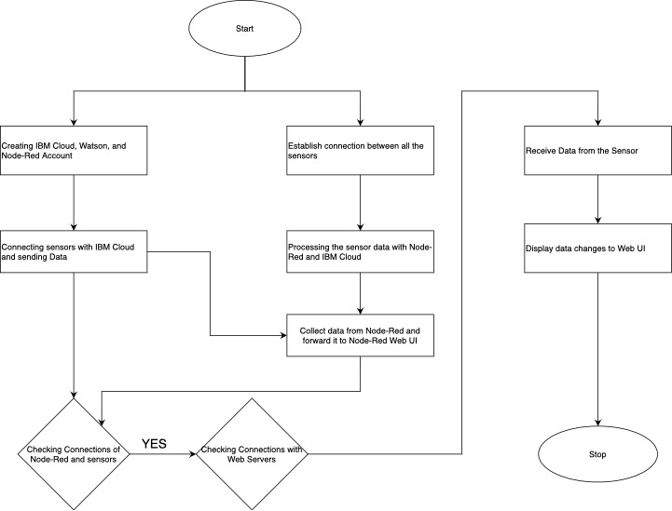
Flowchart

Slide 13
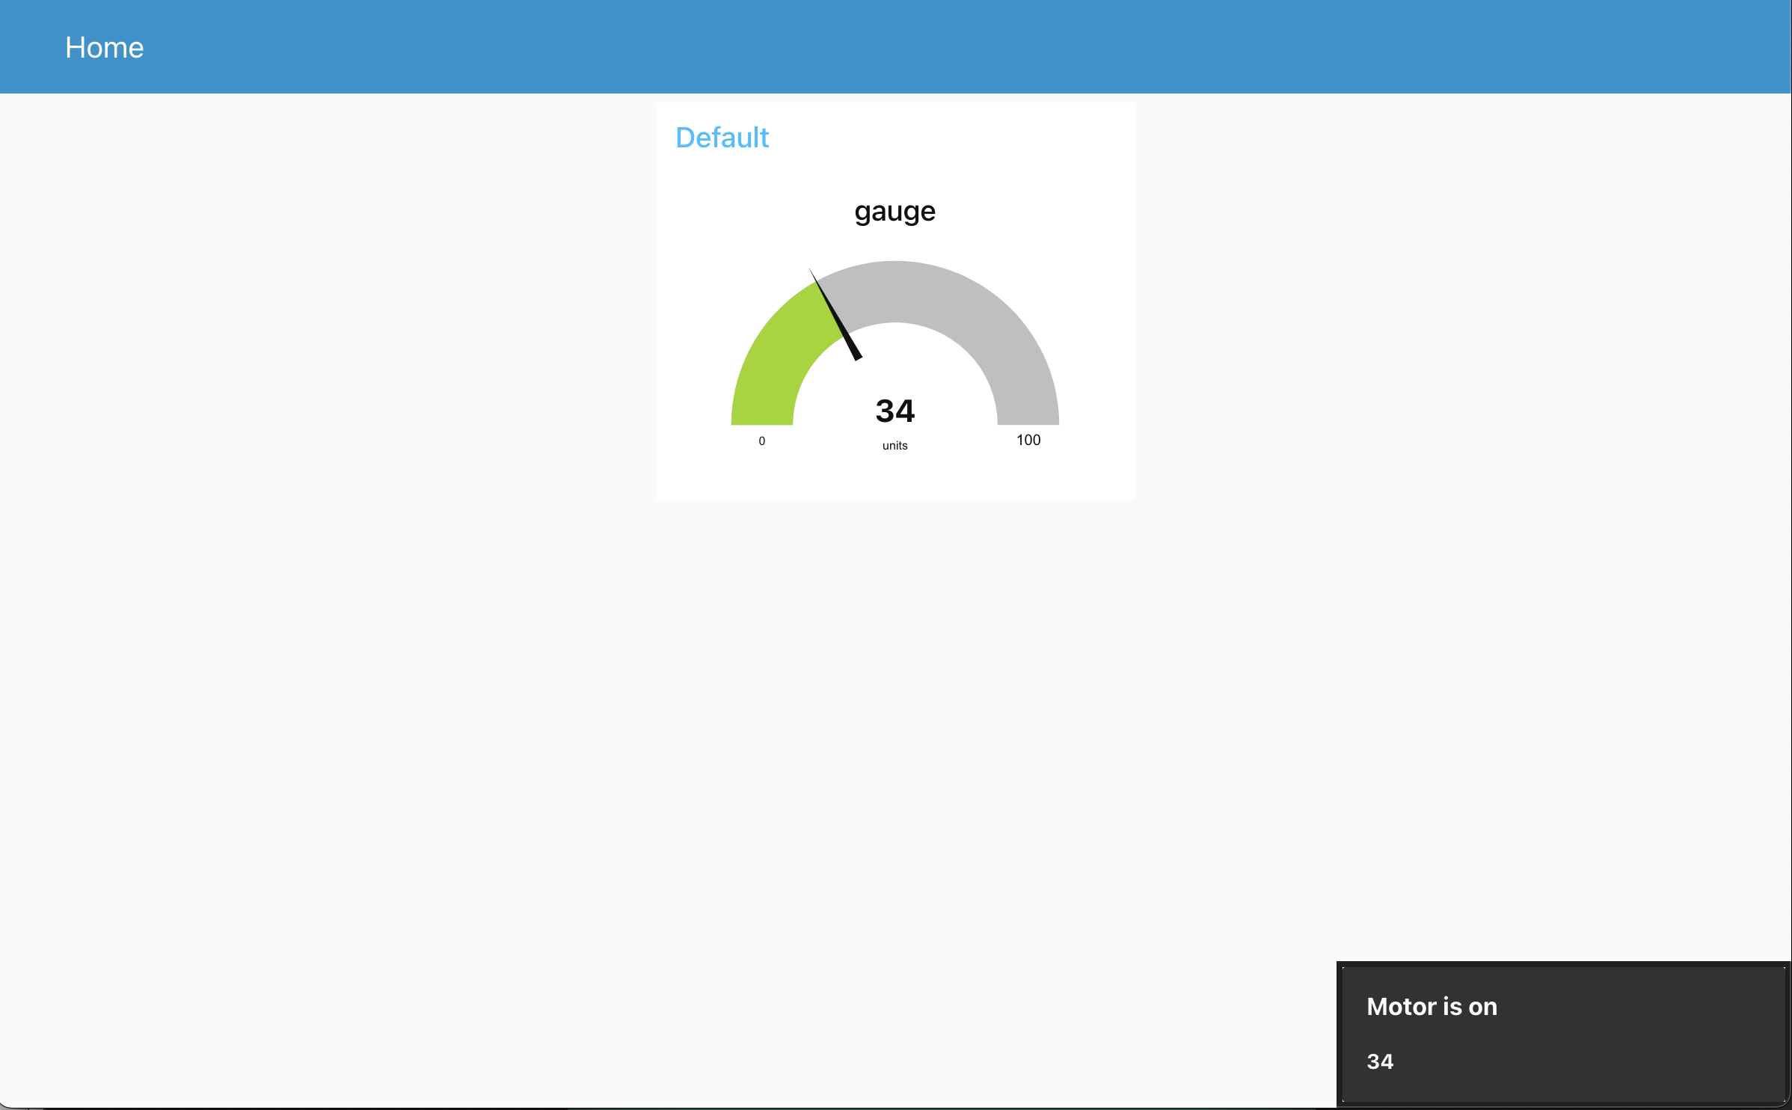
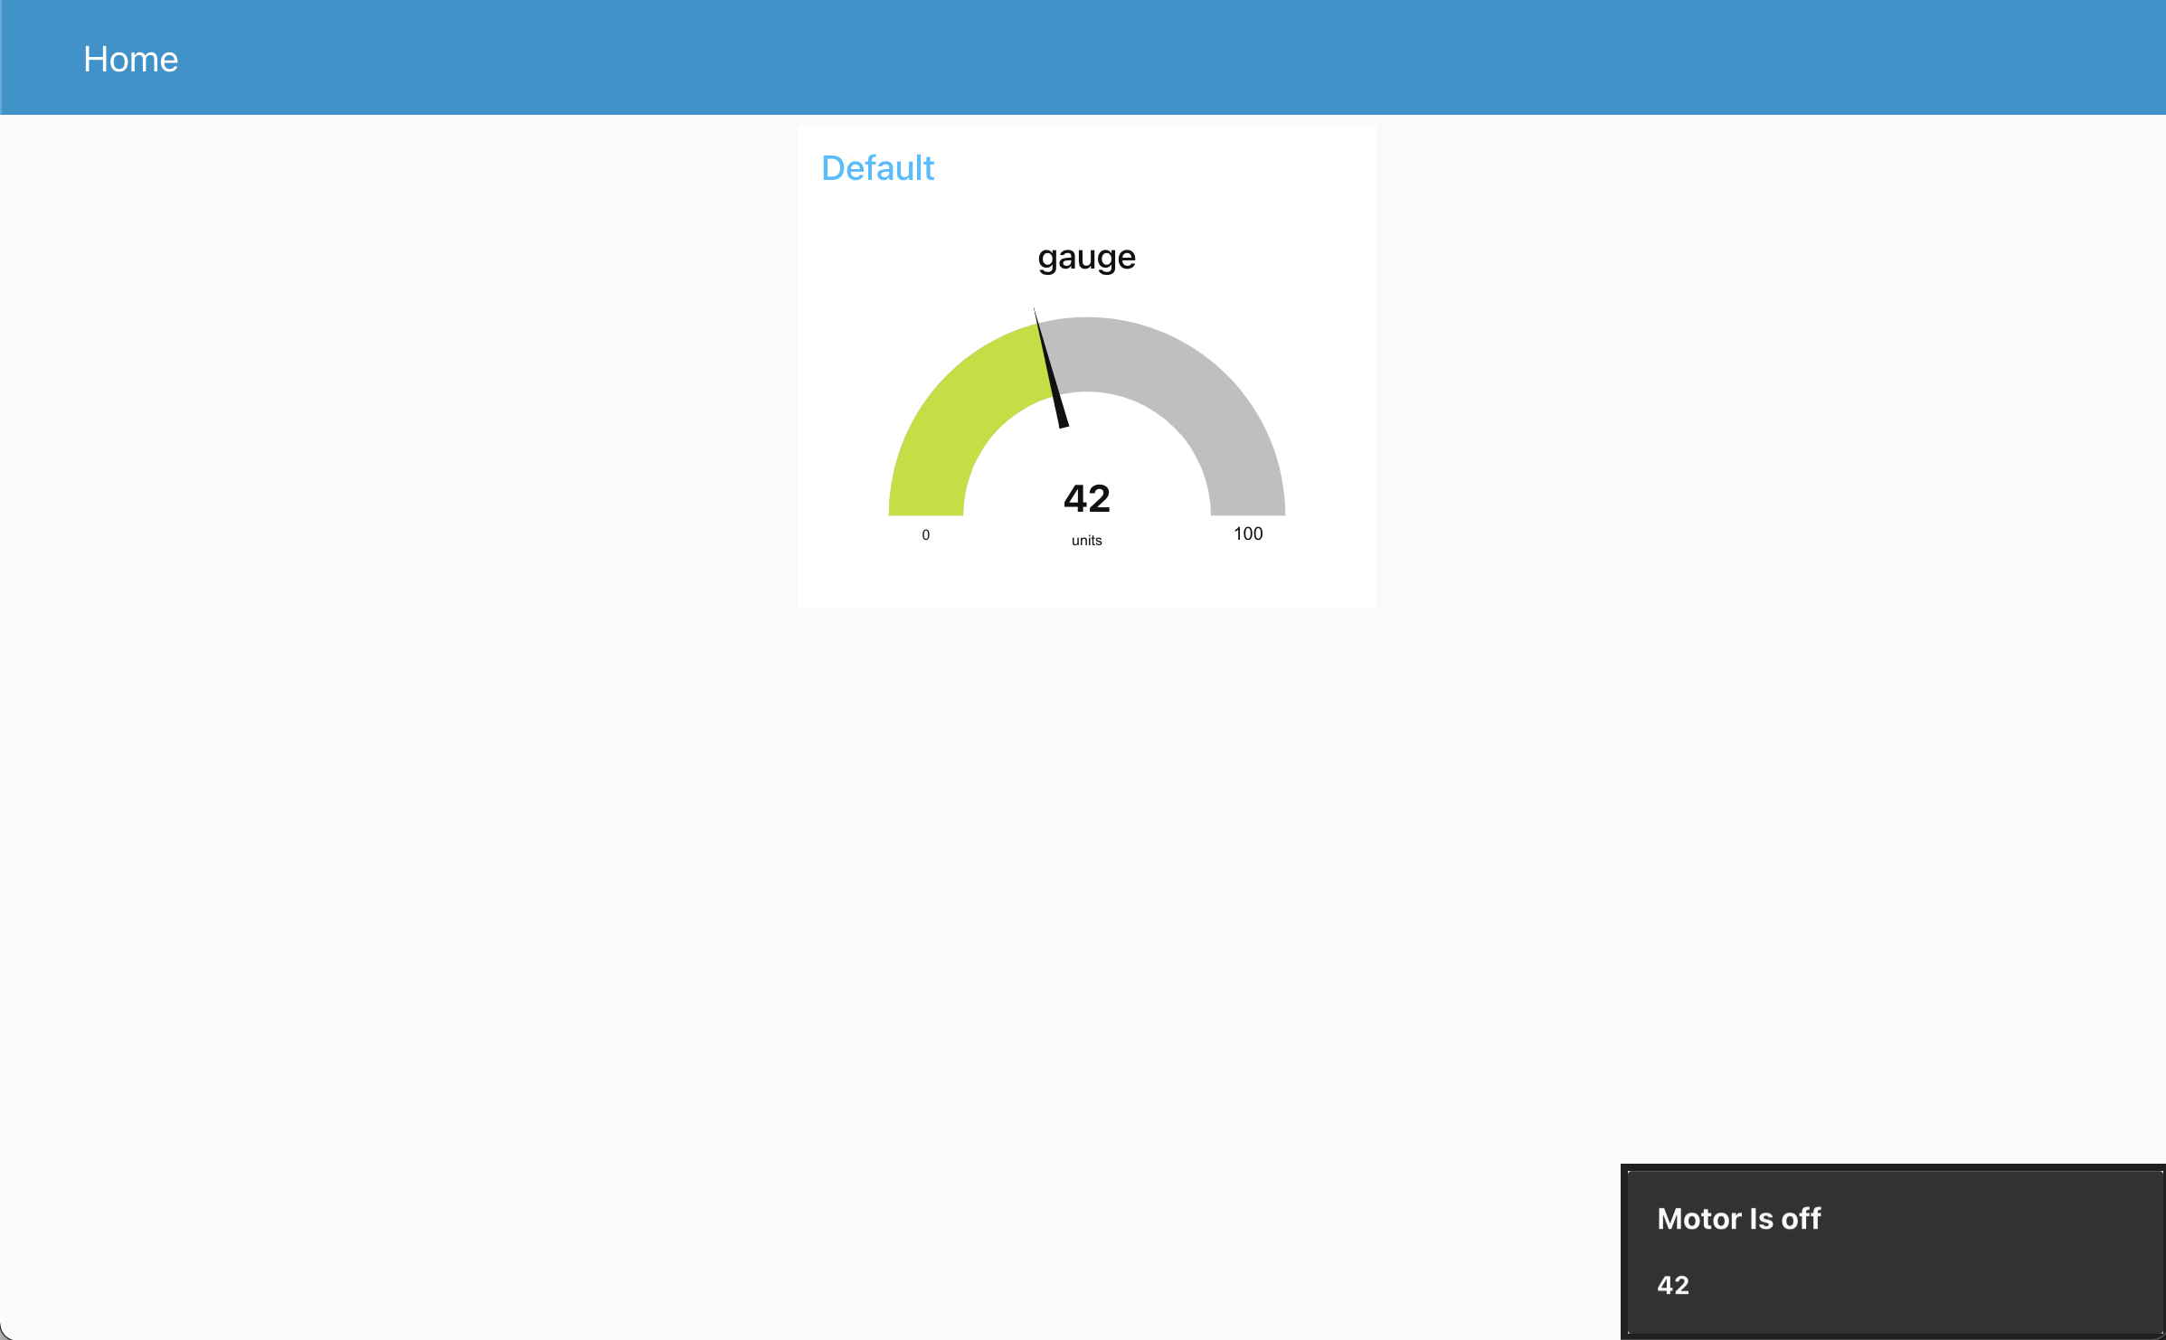
Proof of Context

Slide 14
References
https://smartbridge.teachable.com/
http://watson-iot-sensor-simulator.mybluemix.net/
https://www.ibm.com/in-en/cloud
https://nodered.org/
https://www.python.org/

